Slide 1

Section 11.5 Alternating Series
Lecture 2
Alternating Series Estimates

Slide 2
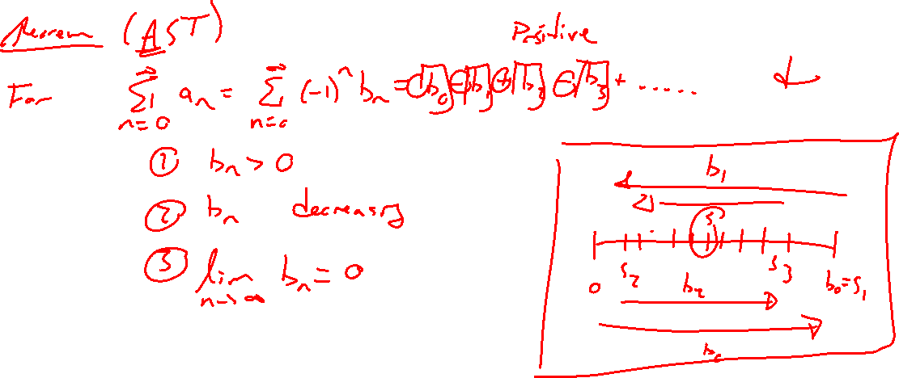
Reminder: Alternate Series Test
Notes:
Remind need to check if alt, bn dec, bn goes to zero

Slide 3
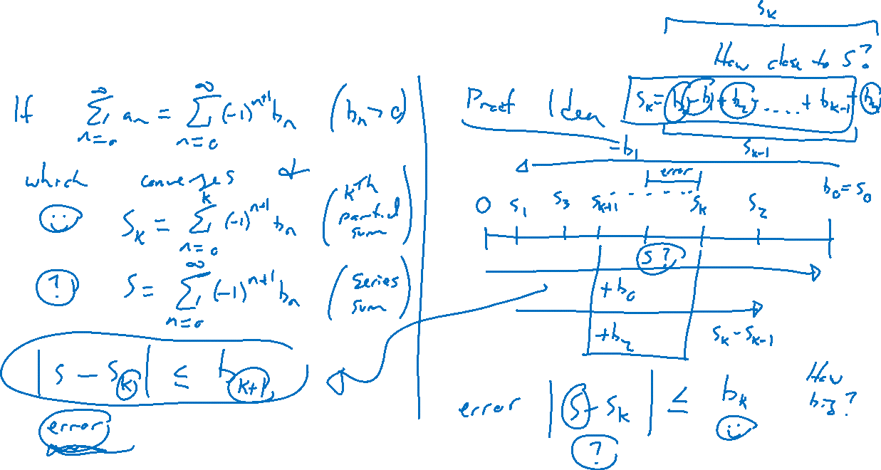
Alternating Series Estimation Theorem
Notes:
If same assumptions are AST are satisfied, then |s-s_n| \leq b_n+1
Reason: Draw parallel parking picture and not distance to true sum.

Slide 4
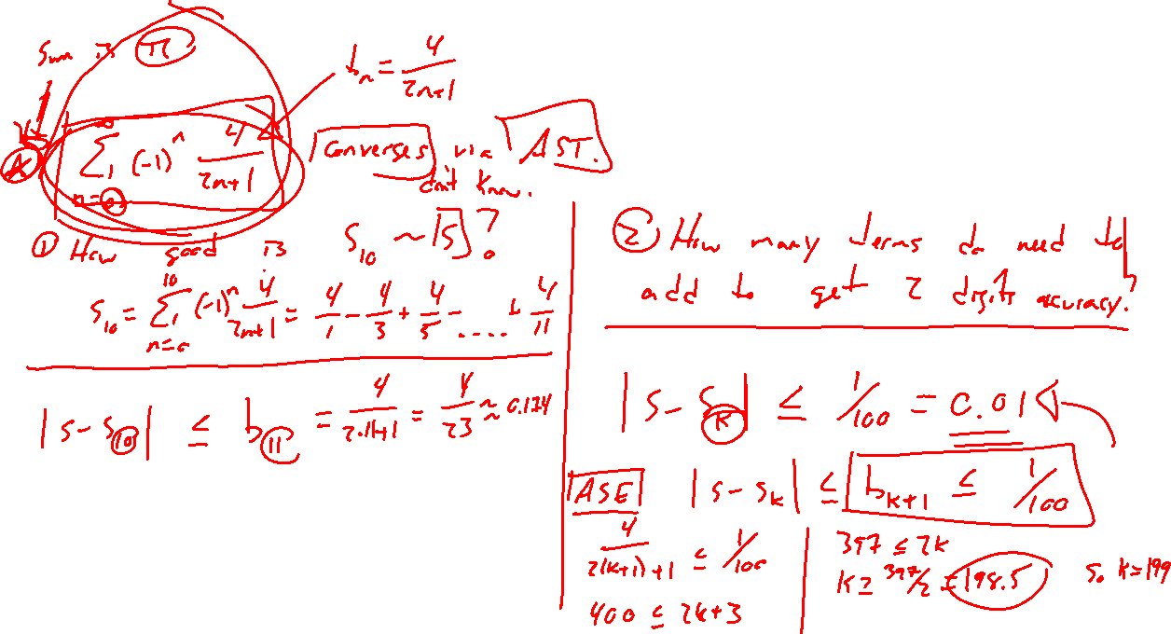
Example
Notes:
\sum (-1)^n 4/2n+1
How many terms are needed to get two digits accuracy?
Check in desmos. ~ 200
Goes to pi, funny. Let's see why.

Slide 5
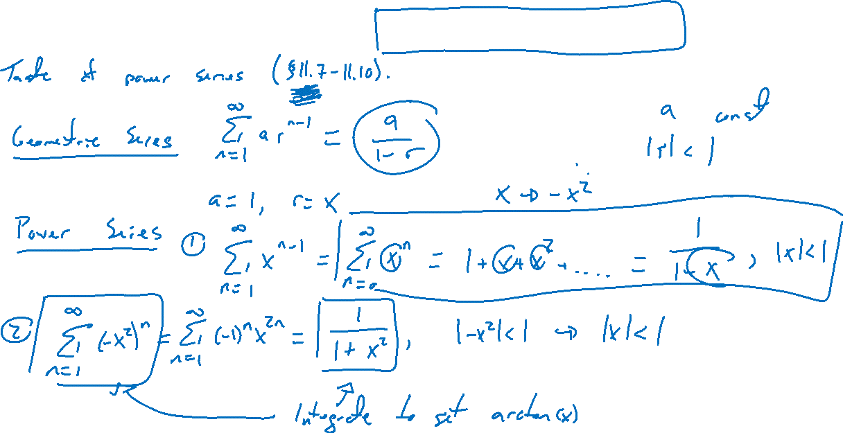
Pi Approximation and Machin Formulas
Notes:
Preview of power series
Geom Series: 1/(1-x) = …
Gives: 1/(1+x^2)
Arctan: arctan(x) = \int 1/(1+x)^2 ~dx =
pi/4 = Arctan(1) = …
https://en.wikipedia.org/wiki/Approximations_of_%CF%80#Arctangent

Slide 6
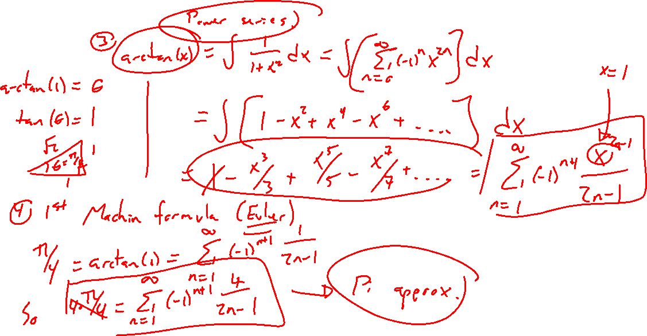
Pi Approximation and Machin Formulas
Notes:
Preview of power series
Geom Series: 1/(1-x) = …
Gives: 1/(1+x^2)
Arctan: arctan(x) = \int 1/(1+x)^2 ~dx =
pi/4 = Arctan(1) = …
https://en.wikipedia.org/wiki/Approximations_of_%CF%80#Arctangent

Slide 7

Section 11.5 Examples and Homework
Rework textbook examples: 2, 3, 4
Write down problem.
Close book and attempt on own.
Compare your solution to text solution, improve your writing.
Exercises: 3, 5, 9, 23, 33

Slide 8

Section Homework Submission to Canvas
Preview of section​
Skim section, write short paragraph summary, list all important definitions / theorems / formulas.​
Notes on video lectures​
Include all details, worked examples, your own thoughts​
Worked examples from text​
Solutions to exercises​
Final reflection of section​
List of key takeaways to remember​

